Slide 1
Cs 429: DATA MINING Lecture 2

Slide 2
Introduction
Data Mining
Problem: Generation of data + Understanding of data
Solution: Communication + Computing
Data: Recorded facts
Information: Patterns or Structure underlying the data

Slide 3
Data Sources
World Wide Web
Customer Transactions
Inexpensive Storage
Data in world’s databases is estimated to double every 20 months
Moore’s Law?

Slide 4
Why Data Mining?
Huge amount of important and undiscovered information exists in databases
Objectives:
To automatically identify strong patterns and structures in data currently available
To express information in comprehensible form, so it can be used for a variety of purposes
To perform better on similar data in future
Benefits:
Problems can be solved by analyzing data
Identified patterns or structures can be generalized for accurate predictions on future data

Slide 5
Issues in Data Mining
Noise
Missing data
Exceptions to rules
Solution
Robust Algorithms
Deal with Issues
Identify Strong Patterns and Structures
Resources
Fast machines

Slide 6
Machine Learning
Learning by Machines:
Thinking + Purpose
Knowledge Acquisition + Ability to use it
Foundational techniques for Data Mining
Different techniques for different problems
Challenge:
Identify the most suitable technique for a given situation

Slide 7
Data Miners
Statisticians
Economists
Forecasters
Data Analysts
Data Modelers
Data Scientists

Slide 8
User-Pattern Examples
User | Pattern
Hunters | Animal Migration Behavior
Farmers | Crop Growth
Politicians | Voter Opinion
Entrepreneur | Business Opportunities

Slide 9
Data Mining Problems
Predicting Customer Loyalty in Competitive Marketplace
Prescribing Contact Lenses for Users
Forecasting Weather
Predicting Iris Type
Predicting CPU Performance
Predicting Labor Negotiations Contracts
Diagnosing Soybean Diseases

Slide 10
Data Mining Problems
Predicting Customer Loyalty in Competitive Marketplace
Prescribing Contact Lenses for Users
Forecasting Weather
Predicting Iris Type
Predicting CPU Performance
Predicting Labor Negotiations Contracts
Diagnosing Soybean Diseases

Slide 11
Contact Lenses Data
S# | Age | Spectacle prescription | Astigmatism | Tear production rate | Recommended lenses
1 | young | myope | no | reduced | none
2 | young | myope | no | normal | soft
3 | young | myope | yes | reduced | none
4 | young | myope | yes | normal | hard
5 | young | hypermetrope | no | reduced | none
6 | young | hypermetrope | no | normal | soft
7 | young | hypermetrope | yes | reduced | none
8 | young | hypermetrope | yes | normal | hard
9 | pre-presbyopic | myope | no | reduced | none
10 | pre-presbyopic | myope | no | normal | soft
11 | pre-presbyopic | myope | yes | reduced | none
12 | pre-presbyopic | myope | yes | normal | hard
13 | pre-presbyopic | hypermetrope | no | reduced | none
14 | pre-presbyopic | hypermetrope | no | normal | soft
15 | pre-presbyopic | hypermetrope | yes | reduced | none
16 | pre-presbyopic | hypermetrope | yes | normal | none
17 | presbyopic | myope | no | reduced | none
18 | presbyopic | myope | no | normal | none
19 | presbyopic | myope | yes | reduced | none
20 | presbyopic | myope | yes | normal | hard
21 | presbyopic | hypermetrope | no | reduced | none
22 | presbyopic | hypermetrope | no | normal | soft
23 | presbyopic | hypermetrope | yes | reduced | none
24 | presbyopic | hypermetrope | yes | normal | none

Slide 12
Structural Patterns
Patterns represented in the form of structure (e.g. Rules, Decision Trees, etc.)
Rule: Antecedent -> Consequent
If tear production rate = reduced then recommendation = none
Else, if age = young and astigmatic = no then recommendation = soft

Slide 13
Contact Lenses Problem
All instances are specified (3 x 2 x 2 x2 = 24)
All values of attributes are mentioned
Categorical data
Errorless Classification

Slide 14
Data Mining Problems
Predicting Customer Loyalty in Competitive Marketplace
Prescribing Contact Lenses for Users
Forecasting Weather
Predicting Iris Type
Predicting CPU Performance
Predicting Labor Negotiations Contracts
Diagnosing Soybean Diseases

Slide 15
Weather Forecast Data 1
S# | Outlook | Temperature | Humidity | Windy | Play
1 | sunny | hot | high | false | no
2 | sunny | hot | high | true | no
3 | overcast | hot | high | false | yes
4 | rainy | mild | high | false | yes
5 | rainy | cool | normal | false | yes
6 | rainy | cool | normal | true | no
7 | overcast | cool | normal | true | yes
8 | sunny | mild | high | false | no
9 | sunny | cool | normal | false | yes
10 | rainy | mild | normal | false | yes
11 | sunny | mild | normal | true | yes
12 | overcast | mild | high | true | yes
13 | overcast | hot | normal | false | yes
14 | rainy | mild | high | true | no

Slide 16
Weather Forecast Problem 1
All instances are not specified; 14 out of (3 x 3 x 2 x2 = 36)
Categorical data
Decision List: Rules interpreted in a sequence
If outlook = sunny and humidity = high then play = no
If outlook = rainy and windy = true then play = no
If outlook = overcast then play = yes
If humidity = normal then play = yes
If none of the above then play = yes

Slide 17
Weather Forecast Data 2
S# | Outlook | Temperature | Humidity | Windy | Play
1 | sunny | 85 | 85 | false | no
2 | sunny | 80 | 90 | true | no
3 | overcast | 83 | 86 | false | yes
4 | rainy | 70 | 96 | false | yes
5 | rainy | 68 | 80 | false | yes
6 | rainy | 65 | 70 | true | no
7 | overcast | 64 | 65 | true | yes
8 | sunny | 72 | 95 | false | no
9 | sunny | 69 | 70 | false | yes
10 | rainy | 75 | 80 | false | yes
11 | sunny | 75 | 70 | true | yes
12 | overcast | 72 | 90 | true | yes
13 | overcast | 81 | 75 | false | yes
14 | rainy | 71 | 91 | true | no

Slide 18
Weather Forecast Problem 2
Categorical and Numeric data (Mixed-attribute problem)
If outlook = sunny and humidity > 84 then play = no
If outlook = rainy and windy = true then play = no
If outlook = overcast then play = yes
If humidity < 85 then play = yes
If none of the above then play = yes

Slide 19
Association Rules
Strongly associate different attribute values
Predicts values of one or more attributes (not only the classification attribute)
If temperature = cool then humidity = normal
If humidity = normal and windy = false then play = yes
If outlook = sunny and play = no then humidity = high
If windy = false and play = no then outlook = sunny and humidity = high

Slide 20
Contact Lenses Problem
Complete Rule Set
If tear production rate = reduced then recommendation = none
If age = young and astigmatic = no and tear production rate = normal then recommendation = soft
If age = pre-presbyopic and astigmatic = no and tear production rate = normal then recommendation = soft
If age = presbyopic and spectacle prescription = myope and astigmatic = no then recommendation = none
If spectacle prescription = hypermetrope and astigmatic = no and tear production rate = normal then recommendation = soft
If spectacle prescription = myope and astigmatic = yes and tear production rate = normal then recommendation = hard
If age young and astigmatic = yes and tear production rate = normal then recommendation = hard
If age = pre-presbyopic and spectacle prescription = hypermetrope and astigmatic = yes then recommendation = none
If age = presbyopic and spectacle prescription = hypermetrope and astigmatic = yes then recommendation = none

Slide 21
Issues with Rules
None of the rules apply
More than one rule applies (Conflicting Recommendations)
Solution: Assign weights or probabilities to rules
Complete Rule Set summarizes and not generalizes data

Slide 22
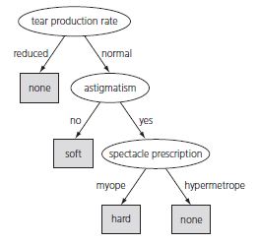
Decision Trees
Contact Lenses Problem

Slide 23
Decision Trees
Pros:
Concise
Comprehensible
Visualized
Cons:
Not necessarily Errorless Classification

Slide 24
Data Mining Problems
Predicting Customer Loyalty in Competitive Marketplace
Prescribing Contact Lenses for Users
Forecasting Weather
Predicting Iris Type
Predicting CPU Performance
Predicting Labor Negotiations Contracts
Diagnosing Soybean Diseases

Slide 25
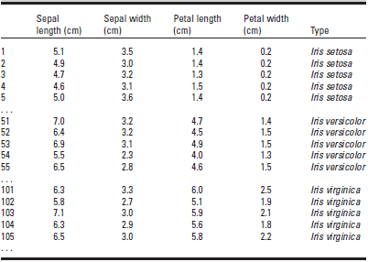
Iris Type Problem
Numeric data
Categorical class

Slide 26

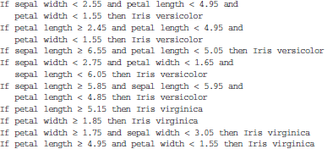
Iris Type Problem
Complete Rule Set

Slide 27
Data Mining Problems
Predicting Customer Loyalty in Competitive Marketplace
Prescribing Contact Lenses for Users
Forecasting Weather
Predicting Iris Type
Predicting CPU Performance
Predicting Labor Negotiations Contracts
Diagnosing Soybean Diseases

Slide 28
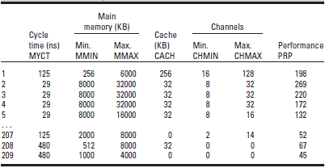
CPU Performance Problem
Numeric data
Numeric class

Slide 29
CPU Performance Problem
Regression
PRP = -55.9 + 0.0489 MYCT + 0.0153 MMIN + 0.0056 MMAX + 0.6410 CACH - 0.2700 CHMIN + 1.480 CHMAX

Slide 30
Data Mining Problems
Predicting Customer Loyalty in Competitive Marketplace
Prescribing Contact Lenses for Users
Forecasting Weather
Predicting Iris Type
Predicting CPU Performance
Predicting Labor Negotiations Contracts
Diagnosing Soybean Diseases

Slide 31
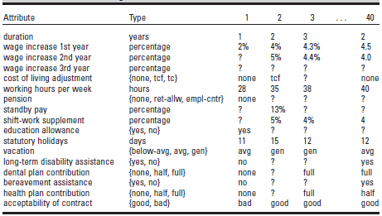
Labor Negotiations Contracts Problem
Missing Values
Not Errorless Classification

Slide 32
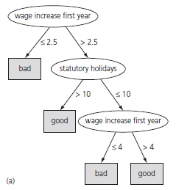
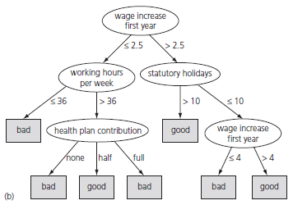
Labor Negotiations Contracts Problem
Decision Trees: Simple vs. Complex

Slide 33
Data Mining Problems
Predicting Customer Loyalty in Competitive Marketplace
Prescribing Contact Lenses for Users
Forecasting Weather
Predicting Iris Type
Predicting CPU Performance
Predicting Labor Negotiations Contracts
Diagnosing Soybean Diseases

Slide 34
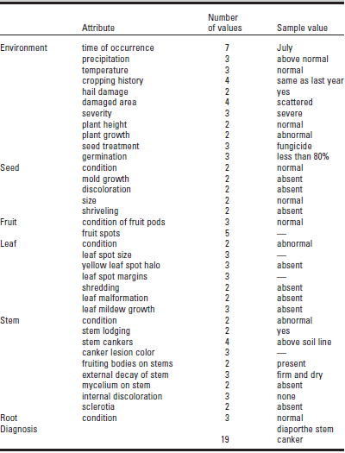
Soybean Diseases Problem

Slide 35
Soybean Diseases Problem
Domain Knowledge
If {leaf condition is normal and stem condition is abnormal and stem cankers is below soil line and canker lesion color is brown}
then diagnosis is rhizoctonia root rot
If {leaf malformation is absent and stem condition is abnormal and stem cankers is below soil line and canker lesion color is brown}
then diagnosis is rhizoctonia root rot

